Slide 1
RETAIL STORE ANALYSIS
using Power BI
Presented by
Kishan Chand .T

Slide 2
Agenda
Problem Statement
Operational & Marketing Questions
Data Description
Measures & Metrics
Dashboards

Slide 3
Problem statement
An online retail store has hired you as a consultant to review their data and provide insights that would be valuable to the CEO and CMO of the business. The business has been performing well and the management wants to Analyse ,what the major contributing factors are to the revenue so they can strategically plan for next year. The leadership is interested in viewing the metrics from both an operations and marketing perspective. Management also intends to expand the business and is interested in seeking guidance into areas that are performing well so they can keep a clear focus on what’s working. They would also like to view different metrics based on the demographic information that is available in the data . So As a consultant you have to anticipate the both business leaders views and frame the questions which should be in a kind of business leaders perspective,and then Finally make a dashboard visualization of your anticipation ‘s with valid measures and metrics ,which should provide valuable data driven approach to the CEO and CMO for better decision making process to their business

Slide 4
Operational Questions
What Is The Total Revenue Generated By Each Country ? What’s The Contribution Of Countries In Total Revenue ?
Which Product Were Sold Out More Across The World ? Individual Country ?
What Is The Monthly/Quarterly Recurring Revenue Generating By Each Country? Is There Any Seasonality In Sales?
How Stock Code's Are Correlated With Respective Revenue And Quantity ?

Slide 5
Marketing Questions
What is the Average Monetary Revenue generated by various customer ?
what is the Recency of customers ?Which kind of customers are visiting the stores oftenly and buying the products?
which type of Revenue generating customers are existing more in each country ?
For oftenly visiting customers, how long does it take for them to place the next order after being delivered the previous one?

Slide 6
Data Description
Dataset consists of 5,41,909 records with 8 attribute columns such as Invoice number, stock code, description, Quantity, Invoice Date, Unit price, Customer ID, Quantity.
Removed negative values Inside the Numerical columns.
Excluded the United Kingdom data

Slide 7
Measures and Metrics
Total Revenue
RFM Classification Measures
RFM overall Category Number
RFM Customer Type
Purchase Frequency
Pareto Metric

Slide 8
DASHBOARDS

Slide 9
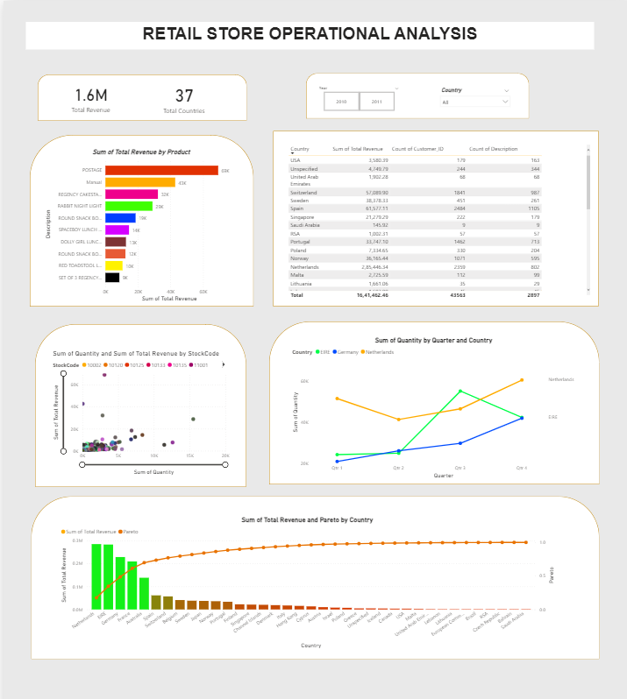
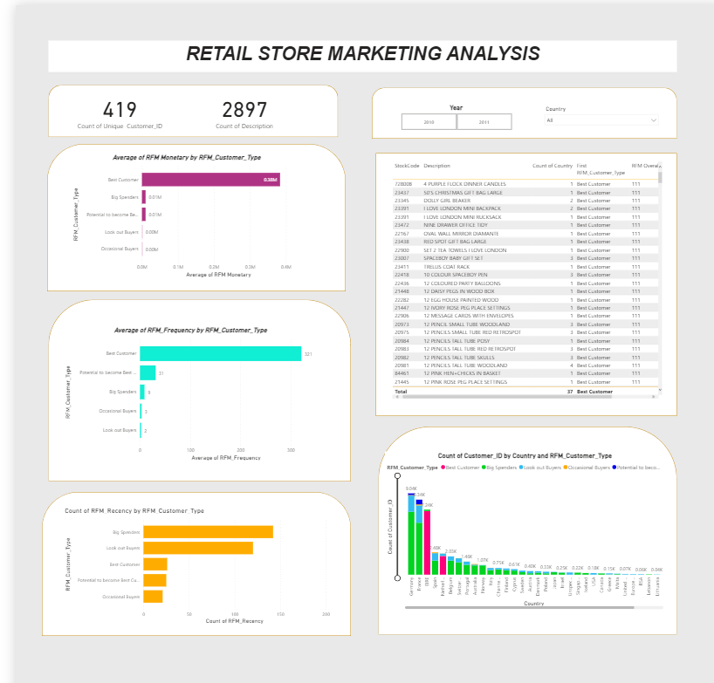
Presented by
Kishan Chand .T

Slide 10

This Photo by Unknown Author is licensed under CC BY-SA

